Slide 2
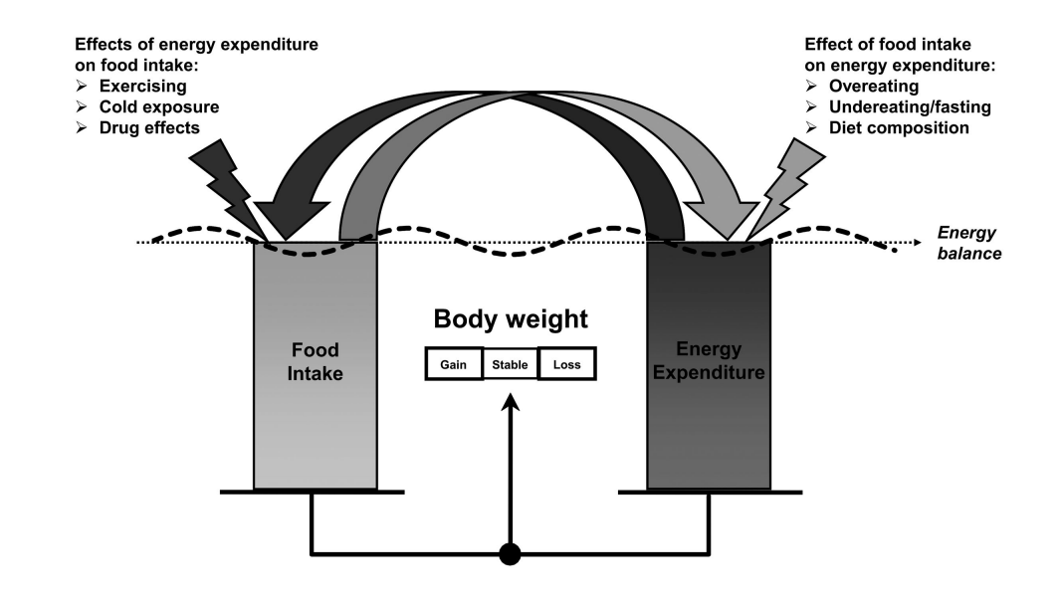
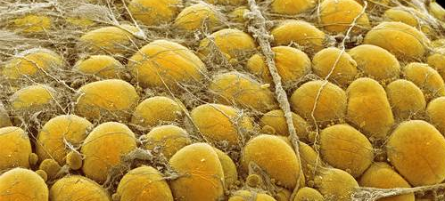
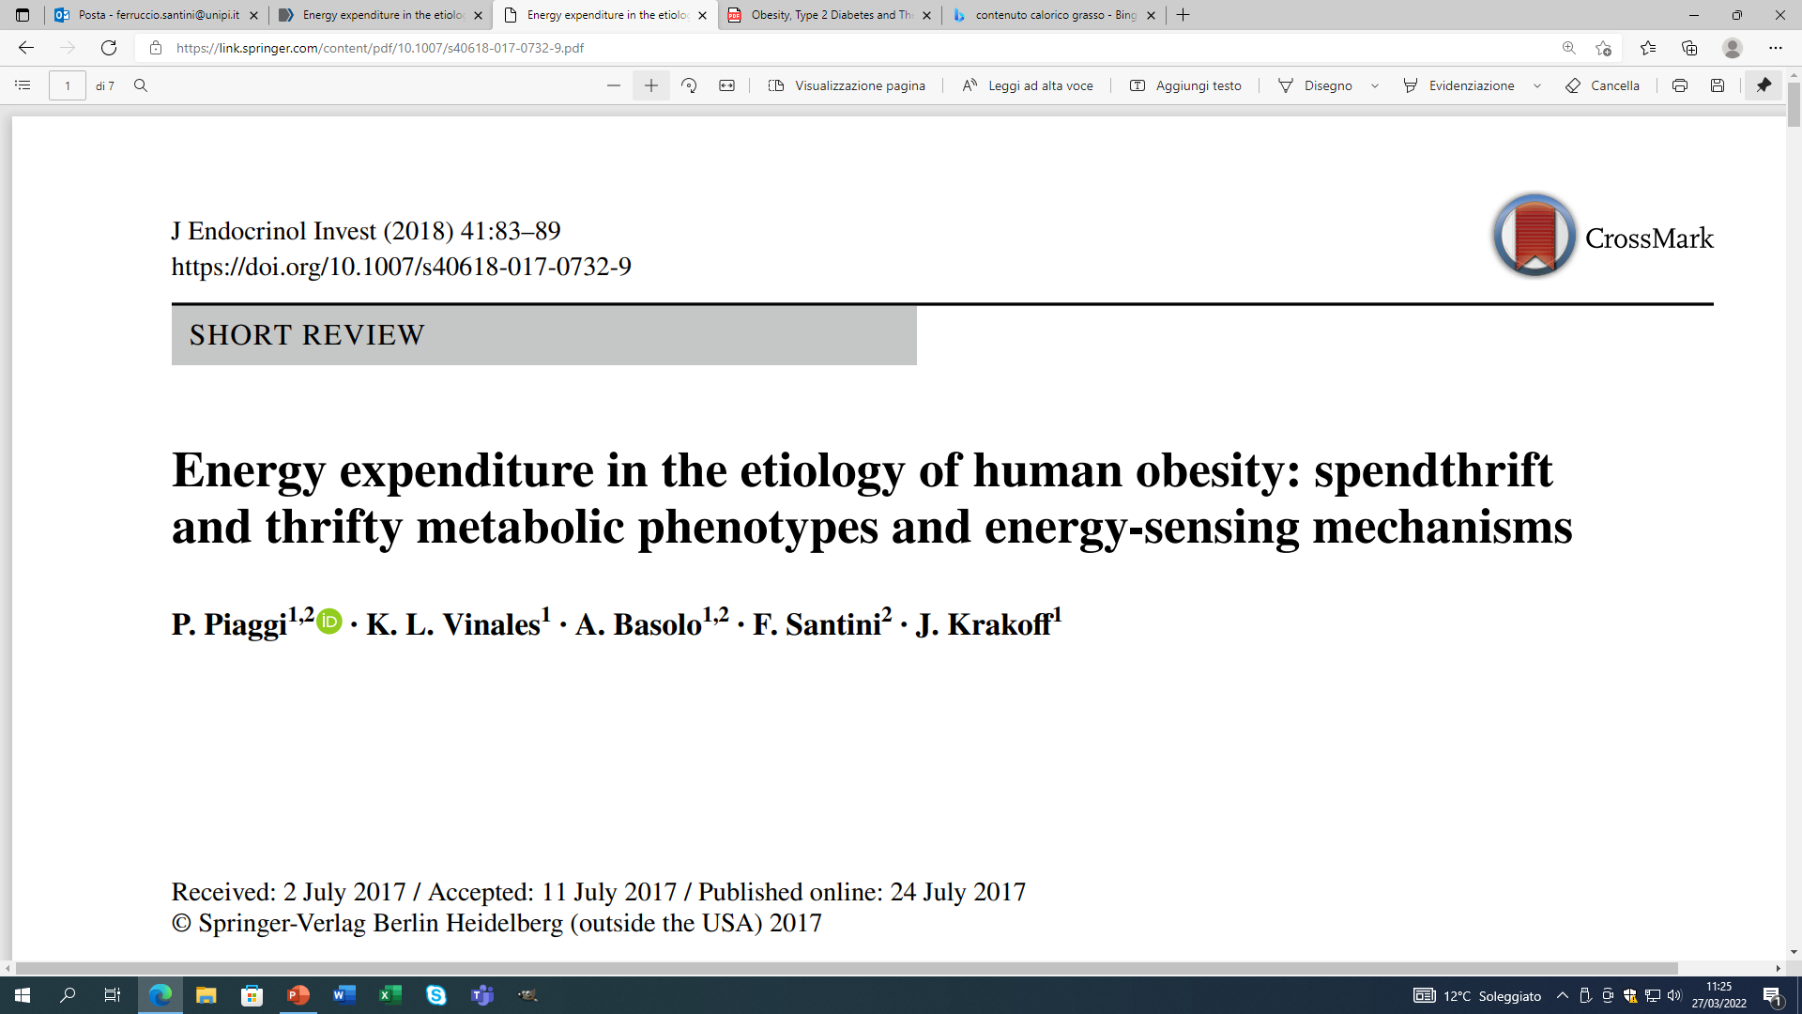
Regolazione del bilancio energetico
Tessuto adiposo
Da:
(modificata)
Piaggi, Vinales, Basolo, Santini, Krakoff, JEI 2018

Slide 3
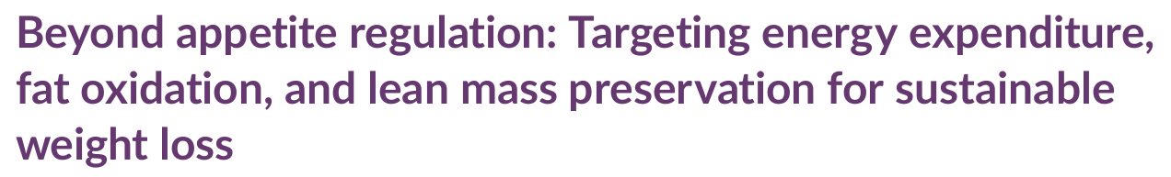
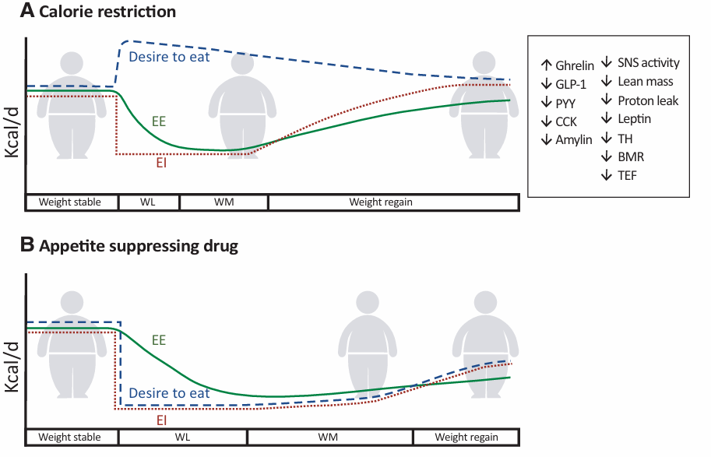
Christoffersen BO et al.

Slide 4
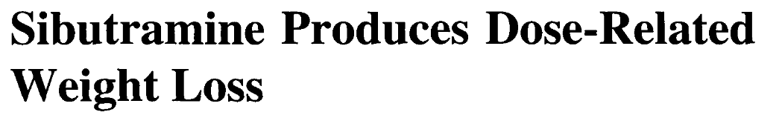
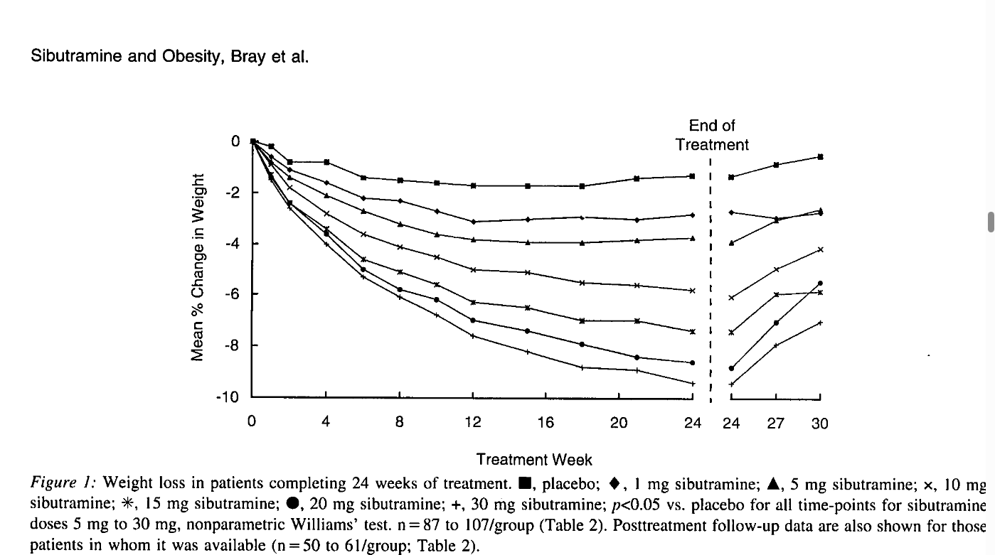


Slide 5
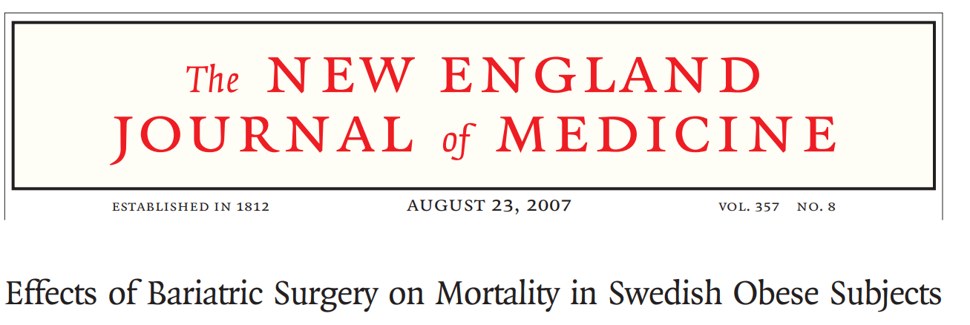
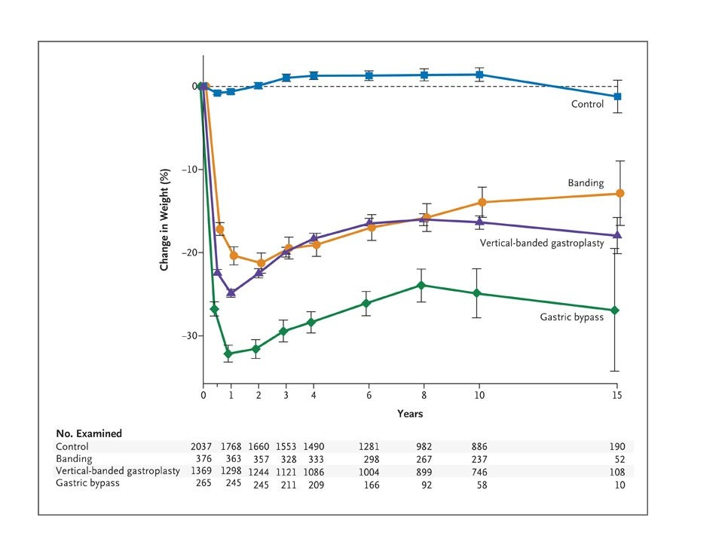

Slide 6
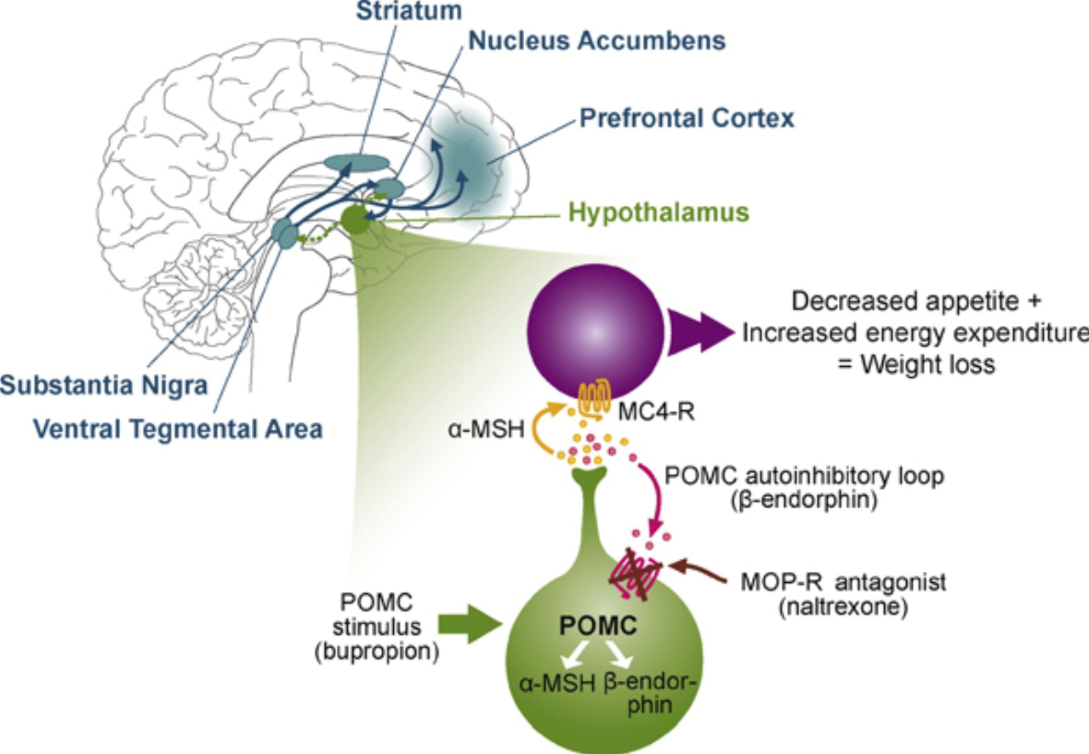
Bupropione-Naltrexone: meccanismo d’azione

Slide 8
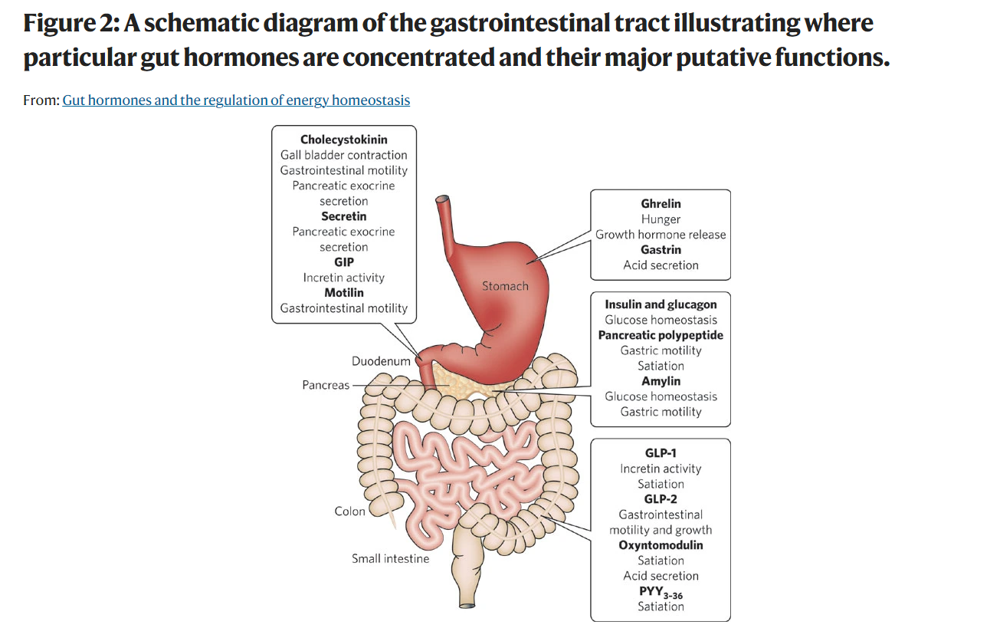
Murphy and Bloom, Nature 2006

Slide 9
Physiological effects of GLP-1
Dimitri P et al. J. Endoc. Soc. 2025

Slide 10
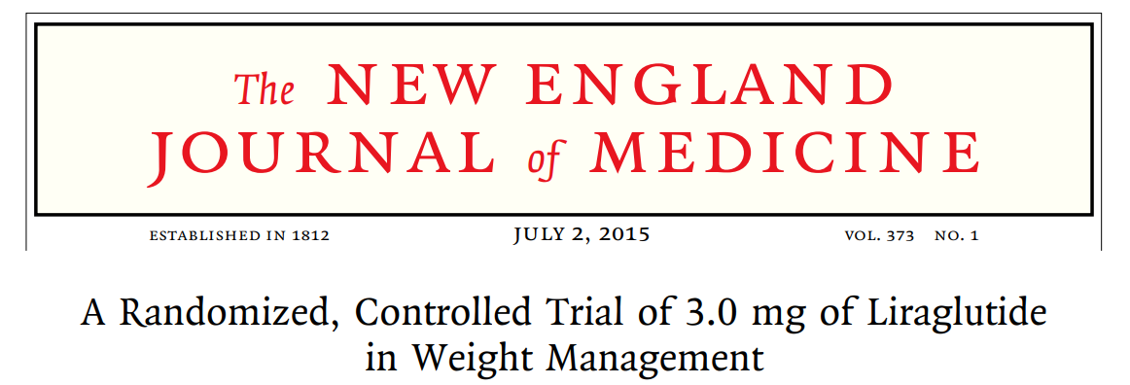
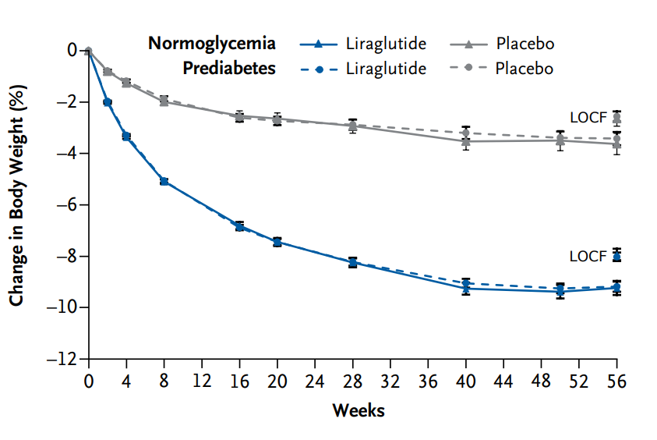
Pi-Sunyer X, et al.

Slide 11
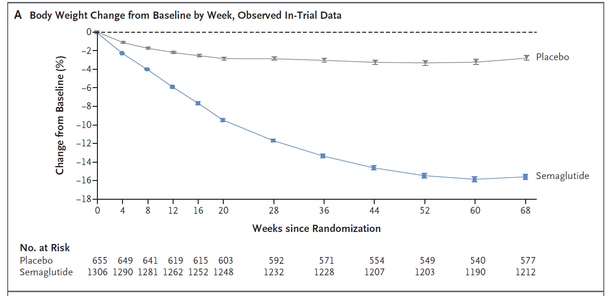

Slide 12
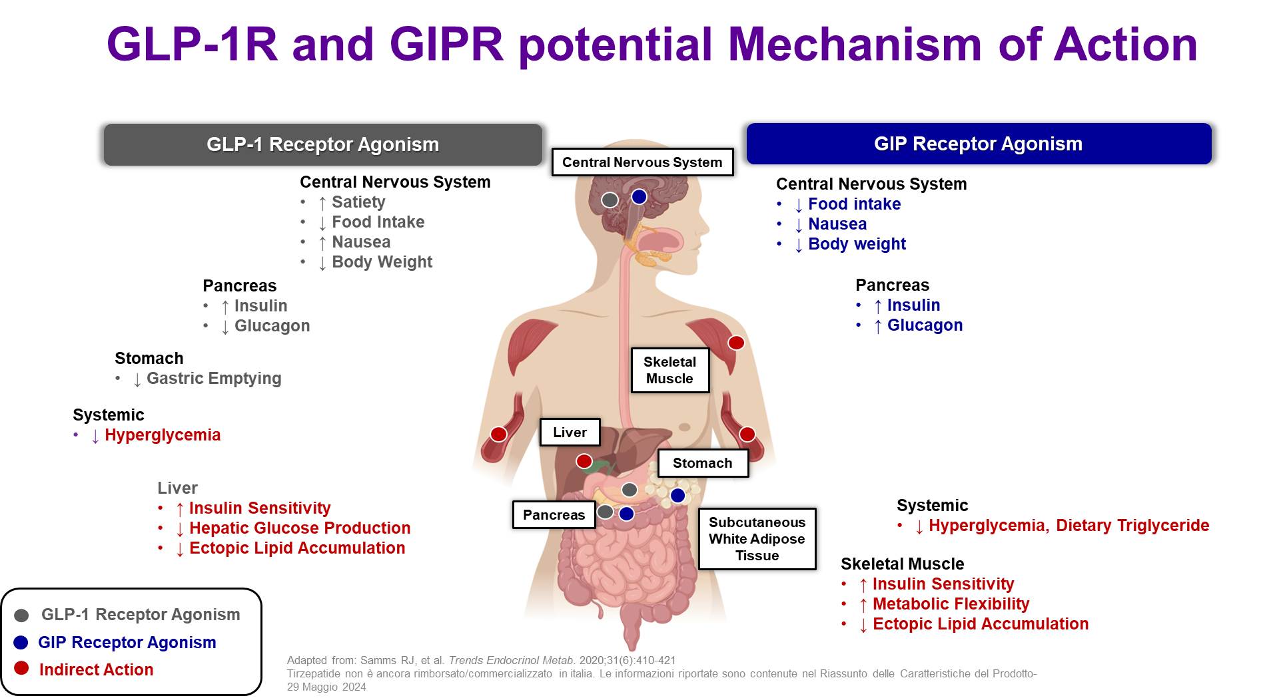

Slide 13
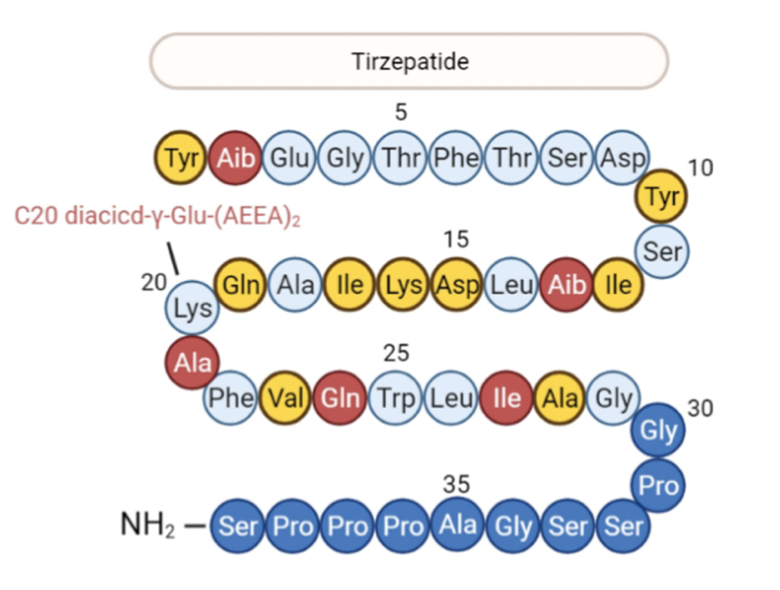
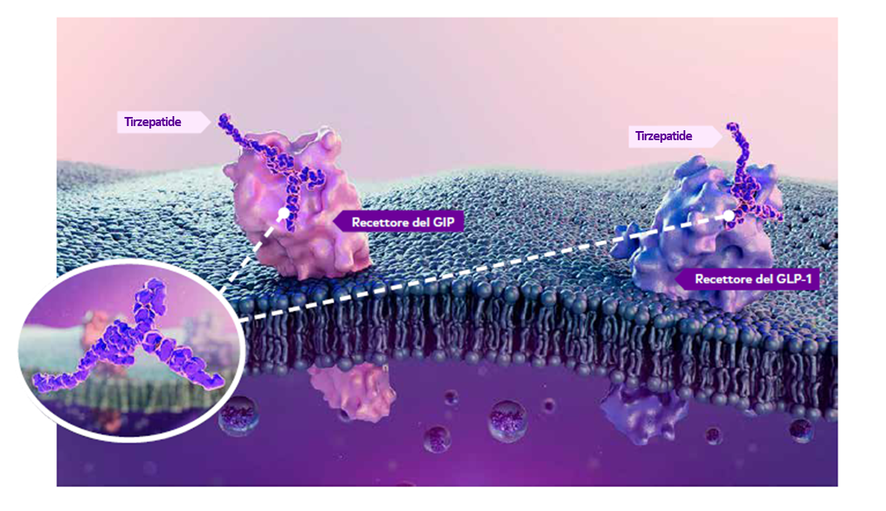

Slide 14
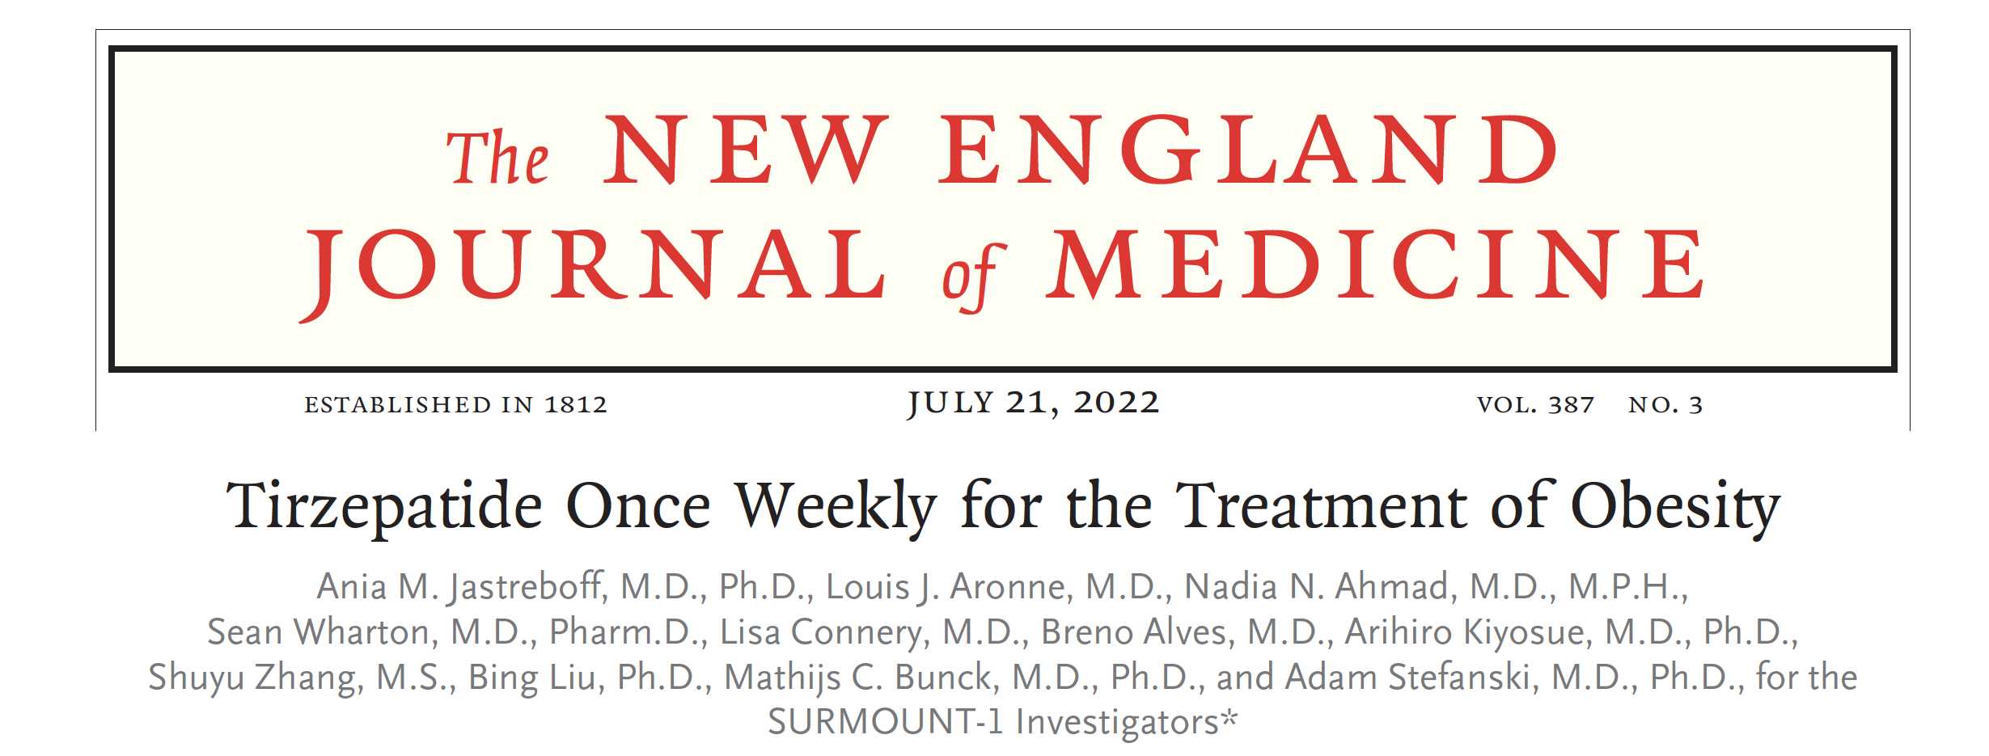
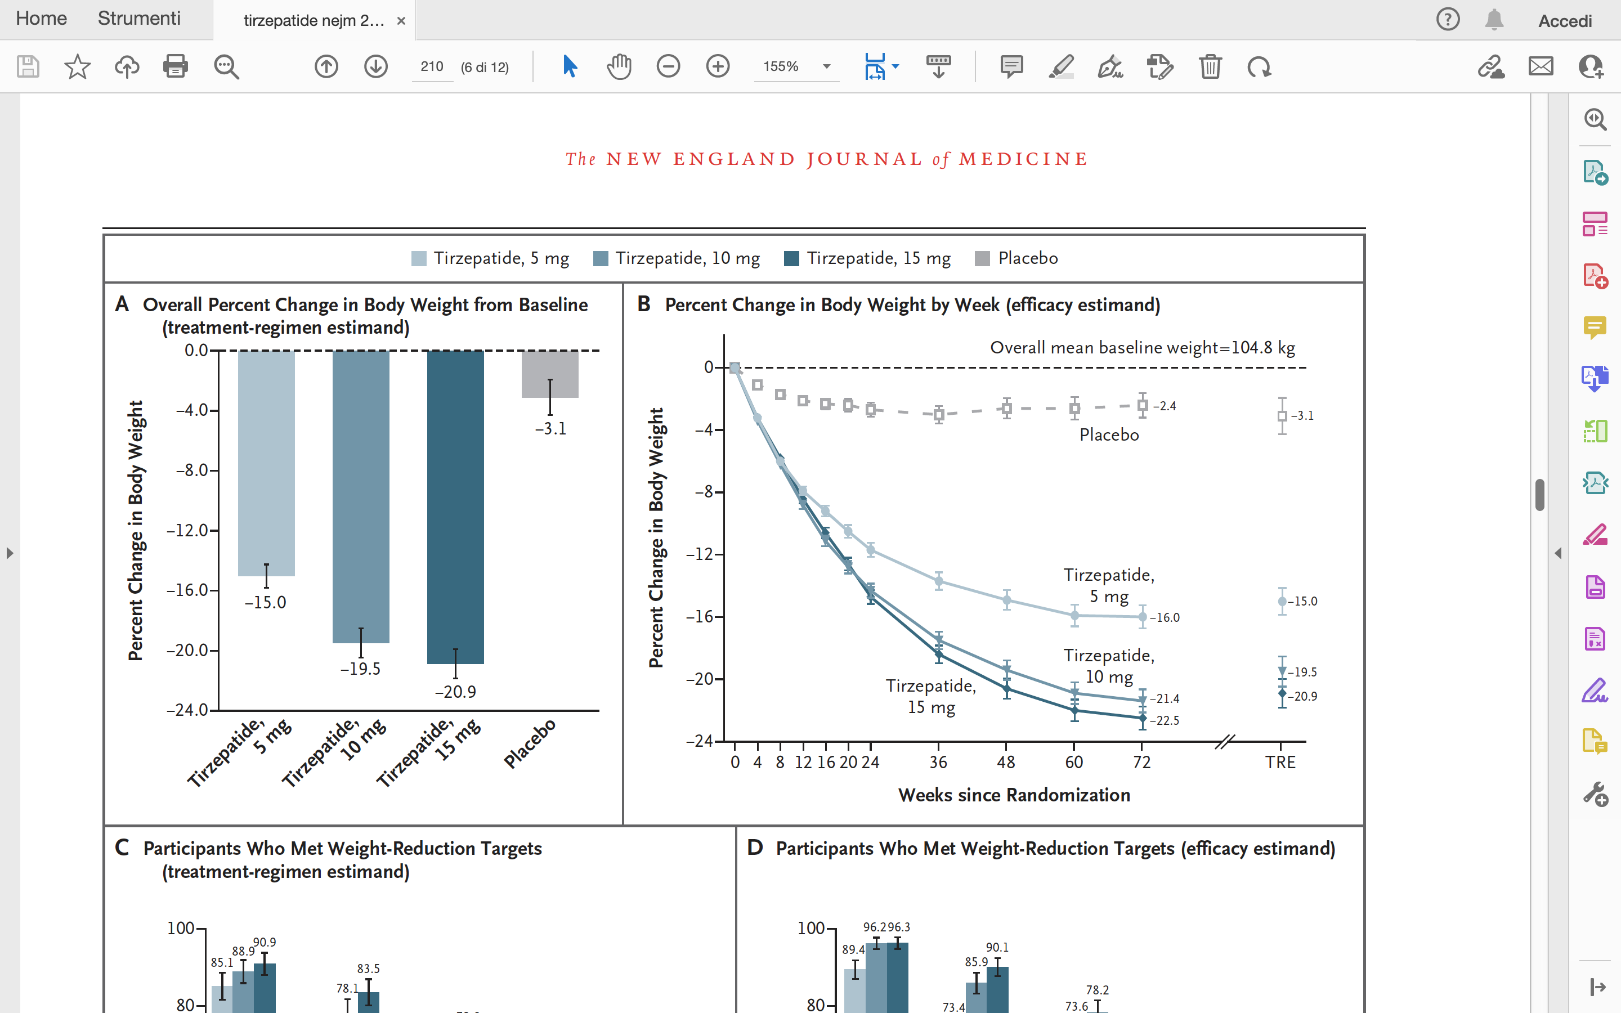

Slide 15

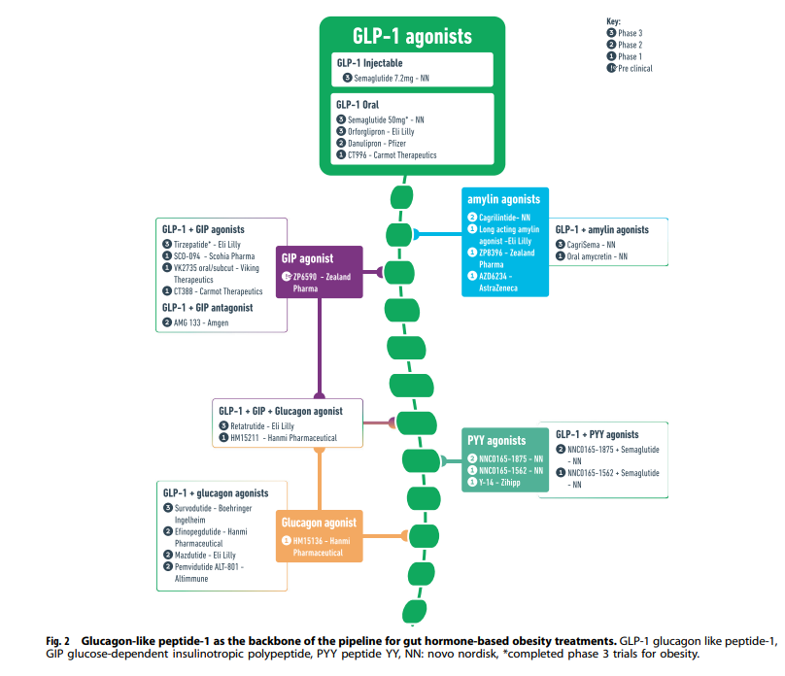


Slide 16
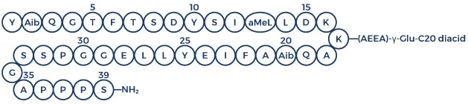
RETRATUTIDE
Retatrutide is a novel triple receptor agonist peptide that targets the glucagon receptor (GCGR), glucose-dependent insulinotropic polypeptide receptor (GIPR), and glucagon-like peptide-1 receptor (GLP-1R).

Slide 17
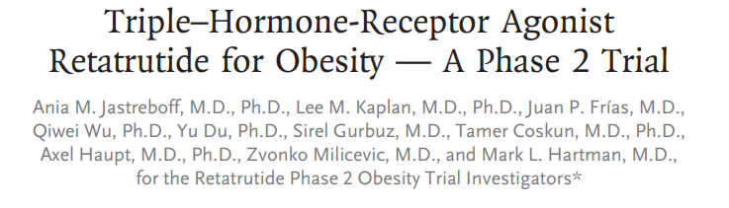
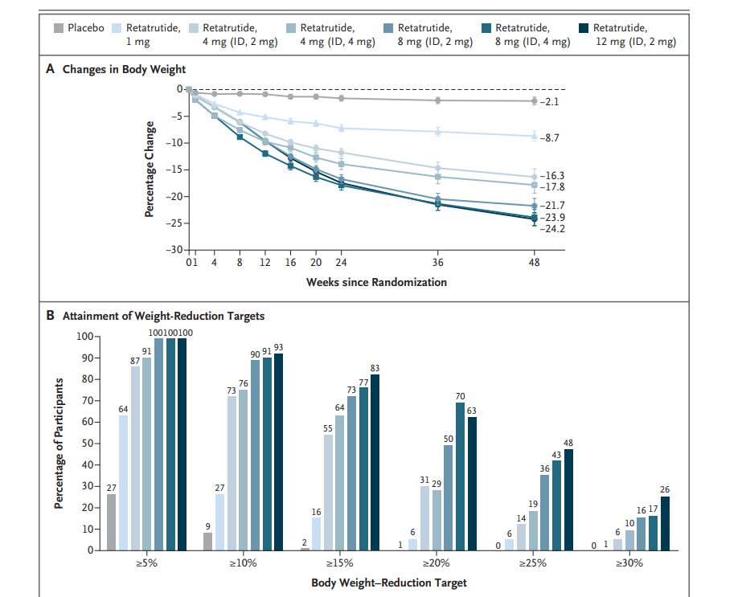

Slide 19
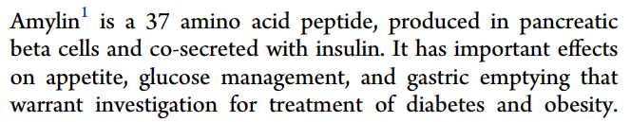
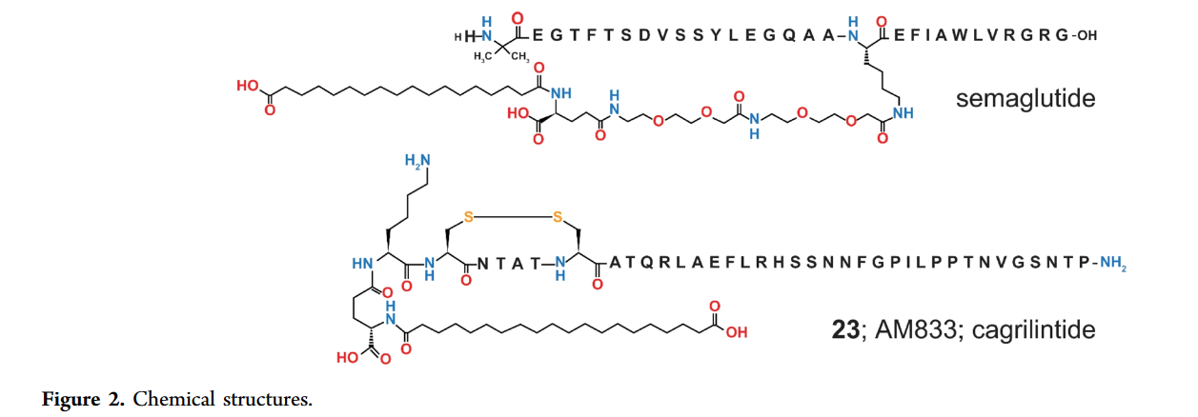
Kruse et al.

Slide 20
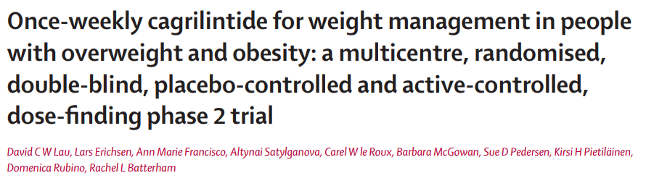
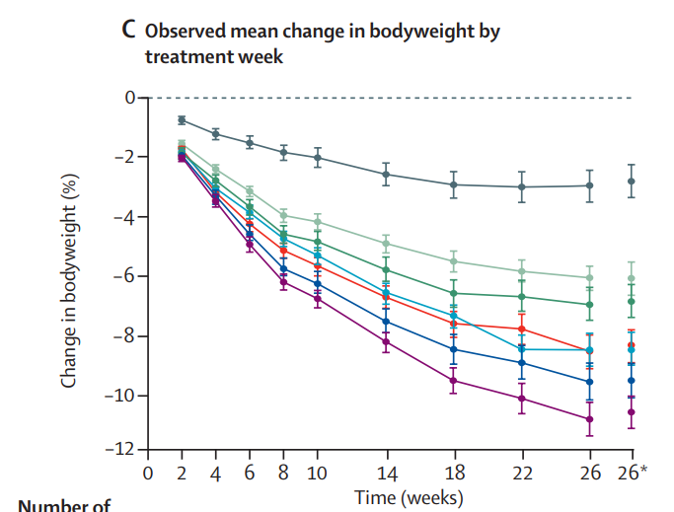


Slide 21
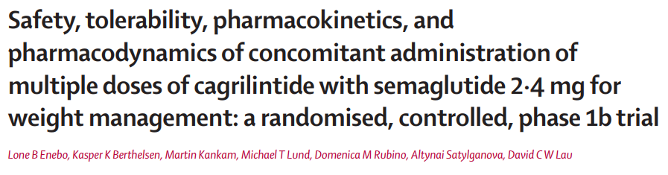
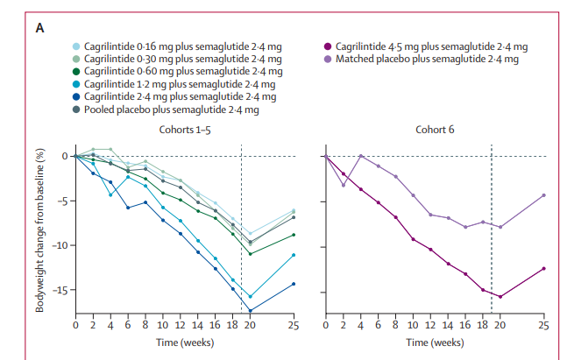


Slide 22
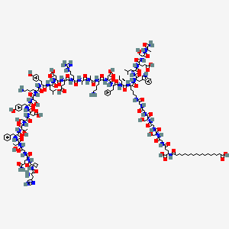
SURVODUTIDE
Survodutide is a dual glucagon-like peptide 1 receptor agonist (GLP-1RA) and glucagon receptor agonist

Slide 23
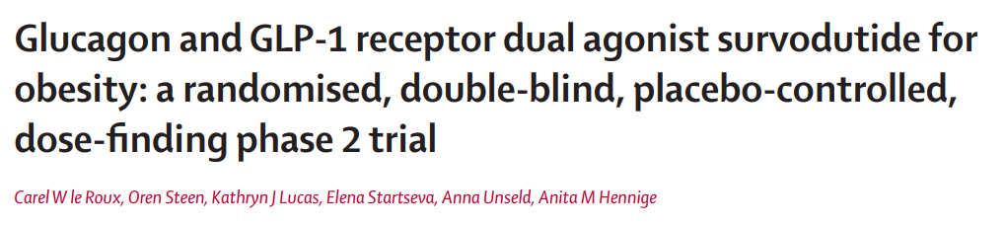
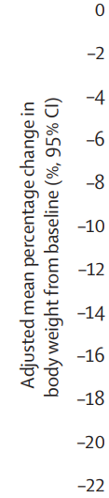
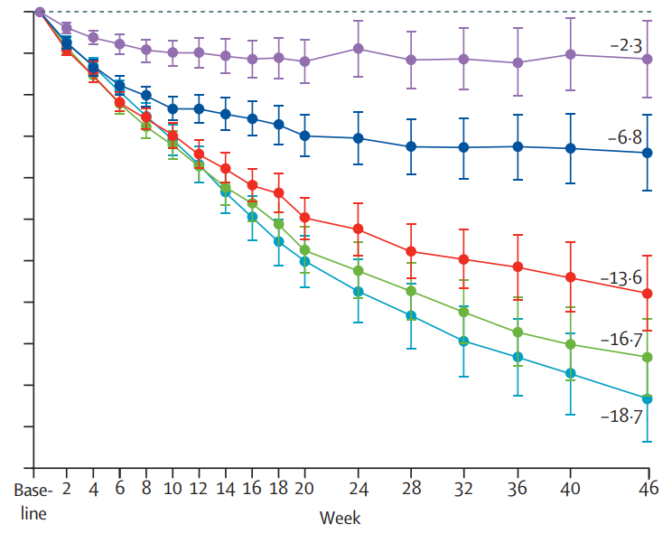

Slide 24
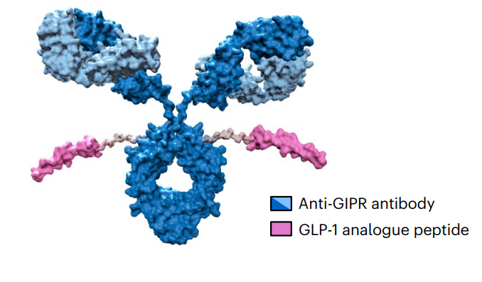
MARIDEBART CAFRAGLUTIDE (MARITIDE)
AMG 133 (now known as maridebart cafraglutide) is an optimized GIPR/GLP-1R bispecific molecule engineered by conjugating a fully human monoclonal anti-human GIPR-Ab with two GLP-1 analogue agonist peptides using amino acid linkers.

Slide 25
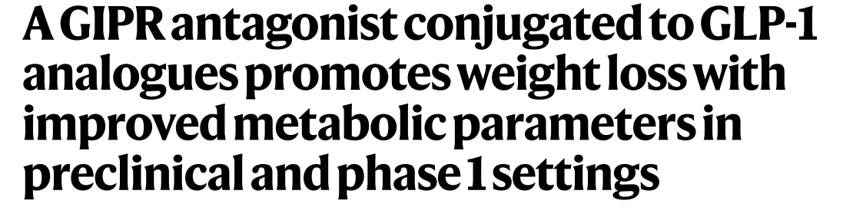
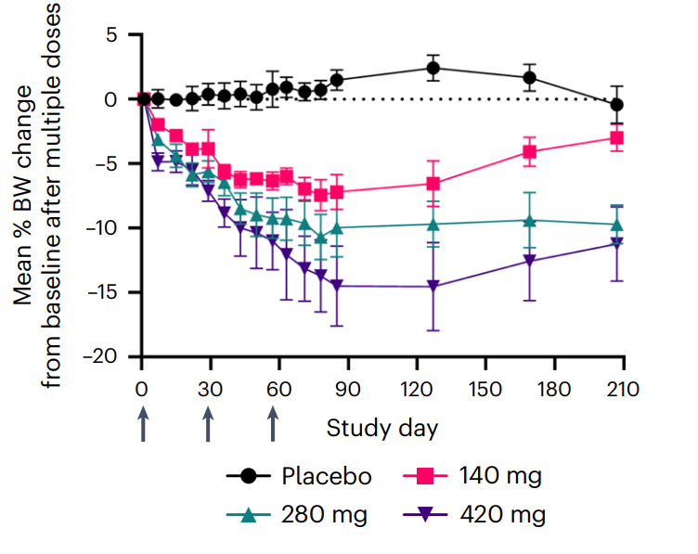
Veniant et al.

Slide 26
LE SFIDE CHE CI ATTENDONO
Gestione degli effetti collaterali
Velocità del calo ponderale
Mantenimento degli effetti a lungo termine
PERSONALIZZAZIONE DELLA TERAPIA

Slide 27


